Slide 1
Beyond simple Web Services
420-C50 S22
Notes:
Roger Wolter Microsoft Corporation

Slide 2
Recap
Data formats
XML (validated by DTDs, XSD)
JSON
Processing, rendering
XSLT
JavaScript, jQuery DOM manipulation
Message exchange patterns
Request/Reply
Defined by
SOAP
ReST

Slide 3
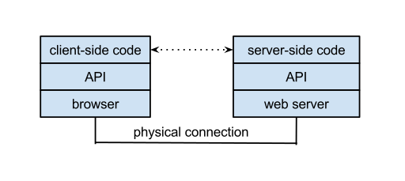
Web API
Generically: A Web API is an application programming interface (API) for either a web server or a web browser.
Write code, call functions
Notes:
Source: Wikipedia https://en.wikipedia.org/wiki/Web_API

Slide 4
Examples
Google
Maps
YouTube
Authentication
Write code, call functions
Need more? Checkout:
http://www.programmableweb.com/apis/directory
Notes:
Source: Wikipedia https://en.wikipedia.org/wiki/Web_API

Slide 5

Under the hood
Why did we learn all that stuff about XML, JSON, AJAX?
What’s under the hood?
Notes:
Under the hood: these APIs all exchange data with a remote/hosted web service.
These APIs abstract all the messaging and interactions.
If you ever want to create your own web API, you’ll need to understand the approaches we’ve covered.

Slide 6
Web Applications – constantly evolving
Technology | Superceeded by / Comments | Benefits
WebForms | MVC | Separation of concerns, Model, View, Controller
WCF | ASP.NET 5 with MVC6 | Platform independent. Simpler.
JavaScript AJAX | jQuery | Simpler abstraction of request/reply
AJAX | Web APIs | Fully abstract all messaging
XML | JSON | XML used to be the dominant hierarchical data format, but most AJAX uses JSON now.
Notes:
https://blog.tonysneed.com/2016/01/06/wcf-is-dead-long-live-mvc-6/

Slide 7
Move from Web Services to Web APIs
Industry is moving to Web APIs
Yahoo
Services offered via REST
Amazon and eBay
SOAP and REST
Google
Used to be on SOAP, but deprecated in favour of REST in 2006
Notes:
Source: Wikipedia https://en.wikipedia.org/wiki/Web_API

Slide 8
Web APIs vs Web Services
Easier to code, less difficult to develop
APIs abstract message exchange and business logic
Less resource intensive (may run faster)
Less data conversions that SOAP-based service APIs
Notes:
Source: Wikipedia https://en.wikipedia.org/wiki/Web_API

Slide 9
Building on Web Services - SOA
Service Oriented Architecture
Building on the idea of having services available that are loosely coupled with common protocols
Each service is independent of each other
This loose coupling allows you to re-use each service in flexible combinations
Decompose a problem into multiple-re-usable services.
Overview Video (1:16)
SOA in more detail (9:04)
Notes:
Simple video: https://www.youtube.com/watch?v=A3_QlYJRVvk
https://www.youtube.com/watch?v=_dFJOSR-aFs (10 minutes)

Slide 10
SOA -analogies
Analogy 1: Remember going from procedural to object oriented?
Consider Service Oriented rather then procedural or object oriented
i.e break the problem down into Services that can be re-used
Analogy 2: Outsourcing
Don’t build it if you can outsource a service
Service abstract details/implementation
Notes:
Simple video: https://www.youtube.com/watch?v=A3_QlYJRVvk
https://www.youtube.com/watch?v=_dFJOSR-aFs (10 minutes)

Slide 11
SOA -analogies
Analogy 3: Cloud
Abstracts hardware/software as a service
Notes:
Simple video: https://www.youtube.com/watch?v=A3_QlYJRVvk
https://www.youtube.com/watch?v=_dFJOSR-aFs (10 minutes)

